Slide 1
Architectural Design

Slide 2
Software Architecture
The software architecture of a program or computing system is the structure or structures of the system, which comprise the software components, the externally visible properties of those components, and the relationships among them.
— Bass. et al.

Slide 3
Why Architecture?
Architecture is a representation of a system that enables the software engineer to:
analyze the effectiveness of the design in meeting its stated requirements,
consider architectural alternatives at a stage when making design changes is still relatively easy, and
reduce the risks associated with the construction of the software.

Slide 4
Data Design
Architectural level
Database design
data mining
data warehousing
Component level
Data structure design

Slide 5
Data Design at Component Level
The systematic analysis principles applied to function and behavior should also be applied to data.
All data structures and the operations to be performed on each should be identified.
A data dictionary should be established and used to define both data and program design.
Data Dictionary : A set of information describing the contents, format, and structure of a database and the relationship between its elements, used to control access to and manipulation of the database.

Slide 6
Data Design at Component Level (Cont.)
Low-level data design decisions should be deferred until late.
The representation of data structure should be known only to those modules that must make direct use of the data contained within the structure.
A library of useful data structures and the operations that may be applied to them should be developed.
A software design and programming language should support the specification and realization of abstract data types.

Slide 7
Architectural Styles
Architectural style describes a system category that encompasses:
a set of components (e.g., a database, computational modules) that perform a function required by a system,
a set of connectors that enable “communication, coordination, and cooperation” among components,
constraints that define how components can be integrated to form the system, and
semantic models that enable a designer to understand the overall properties of a system.

Slide 8
Architectural Styles
Data-centered architecture
Data flow architecture
Call and return architecture
Object-oriented architecture
Layered architecture

Slide 9
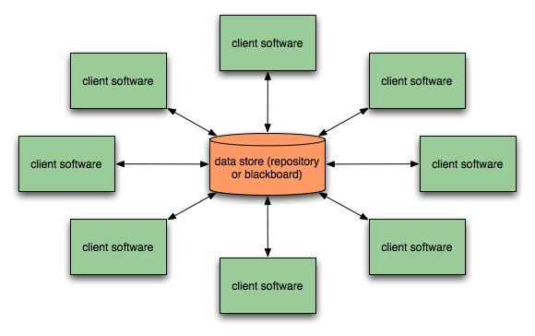
Data-Centered Architecture

Slide 10
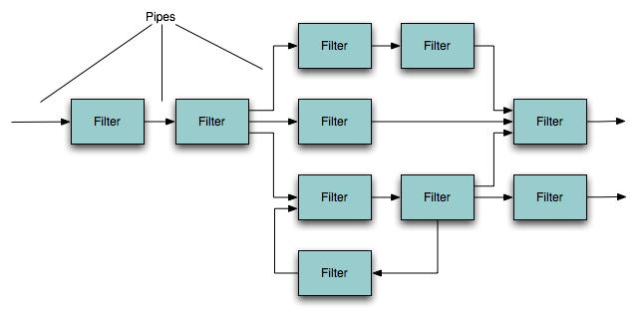
Data-Flow Architecture

Slide 11
Data-Flow Architecture
Basically used for Stream processing.
Data flow architecture (pipe and filter pattern) has a set of components, called filters
Filters are connected by pipes that transmit data from one component to the next.
Each filter works independently of those components upstream and downstream, is designed to expect data input of a certain form, and produces data output (to the next filter) of a specified form.
The filter does not require knowledge of the working of its neighboring filters.

Slide 12
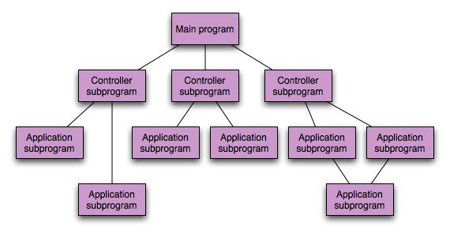
Call and Return Architecture

Slide 13
Call and Return Architecture
Types
Main program/subprogram architectures.
Remote procedure call architectures.

Slide 14
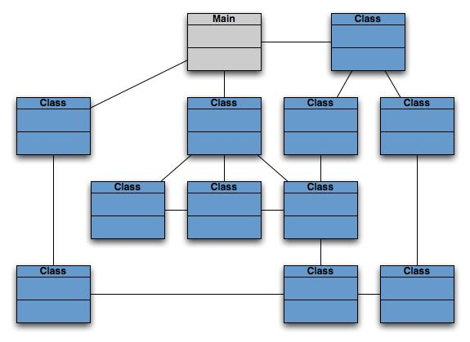
Object-Oriented Architecture

Slide 15
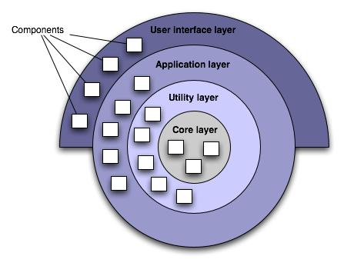
Layered Architecture

Slide 16
Layered Architecture
A number of different layers are defined, each accomplishing operations that progressively become closer to the machine instruction set.
At the outer layer, components service user interface operations.
At the inner layer, components perform operating system interfacing.
Intermediate layers provide utility services and application software functions.

Slide 17
Architectural Design
Architectural context diagrams model how software interacts with external entities
Archetypes are classes or patterns that represent an abstraction critical to the system
Architectural components are derived from the application domain, the infrastructure, and the interface.

Slide 18
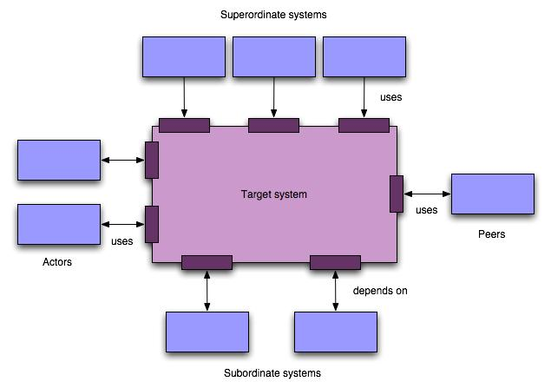
Architectural Context Diagram

Slide 19
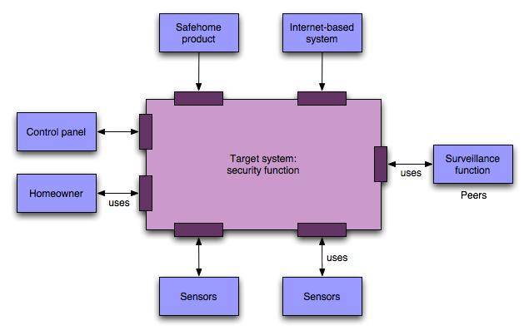
SafeHome ACD

Slide 20
Archetypes
An Archetype is a class or pattern that represents a core abstraction that is critical to the design of an architecture for the target system.
Few archetypes can define relatively complex system.
These represent stable elements of the architecture.

Slide 21
SafeHome Archetypes
SafeHome security function might define following archetypes
Node
Sensors
Alarm indicators
Detector
Indicator
Controller

Slide 22
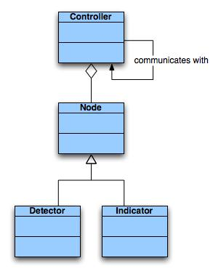
SafeHome Archetypes
Archetypes form the basis for the architecture but are abstractions that must be further refined, as the design proceeds.
E.g. Detector might be refined into a class hierarchy of sensors.

Slide 23
Architectural Components
As the software architecture is refined into components the structure of the system begins to emerge.
Choosing components
Application (business) domain
From the Analysis Model
Infrastructure components
Memory management
Communication components
Database components
Task management components
Interface
Components that process data that flows across the interfaces. (e.g. the interfaces shown in ACD earlier)

Slide 24
SafeHome components
Some top level components for SafeHome security function:
External Communication management – coordinates communications with external entities such as Internet based systems, external alarm notification.
Control panel processing – manages all control panel functionality.
Detector management – coordinates access to all detectors attached to the system.
Alarm processing – verifies and acts on all alarm conditions.

Slide 25
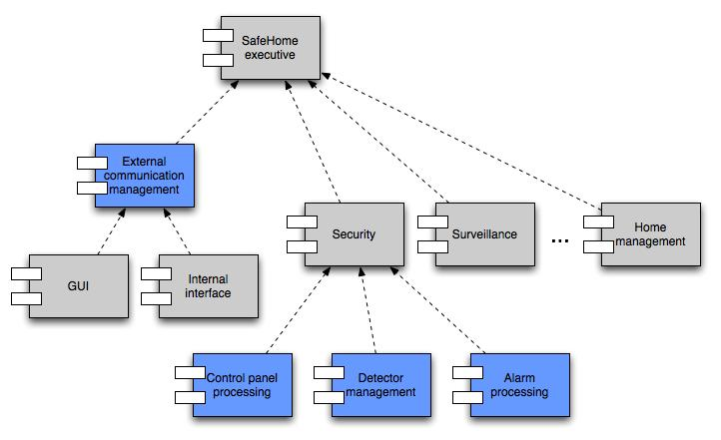
Component Structure (Top level components)

Slide 26
Component Elaboration
Each of these top level components need to be elaborated iteratively and then positioned in the overall SafeHome architecture.

Slide 27
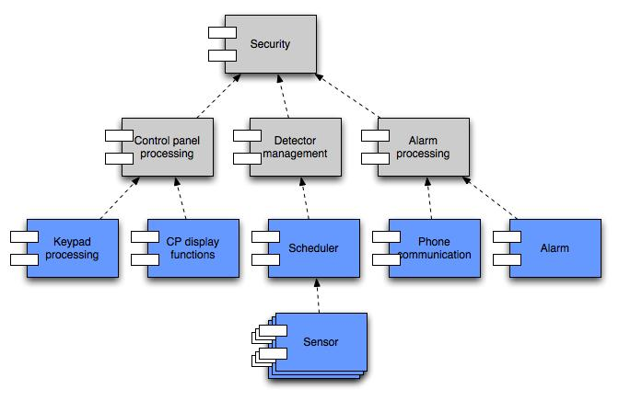
Component Elaboration

Slide 28
END

